Slide 1
A Survey on Topic Model for Semantic PageRank
Internet Database Lab.
School of Computer Science and Engineering
Seoul National University
Hee-Gook Jun
Jun 25, 2015
Notes:
Good Afternoon. My name is Hee-Gook Jun, a PhD student in the Internet Database Lab.
I’m honored to have this opportunity to tell you about my research.
Today I’m going to talk about topic model, and its adoption of semantic PageRank.

Slide 2
Outline
Introduction
Backgrounds
Topic Model
Research Direction
Notes:
I’ve divided my presentation into four parts.
In the first chapter, I will be discussing Web Information Retrieval and introducing the motivation of my research.
The second chapter is backgrounds on semantic ranking, and big data approach.
In the following chapter, I will mainly discuss about Topic Model.
Finally, I’ll talk about my research direction.

Slide 3


Web Information Retrieval
Purpose
Retrieve high quality pages that are relevant to user’s need
Utilizable
Efficient
Accurate
Page
Repository
Query
Engine
Ranking
Crawler
Indexer
WWW
Notes:
Many technologies are developed for implementing Web information retrieval system.
It is important to build efficient overall Information Retrieval framework as well as to build an utilizable query engine.
It is also important to generate effective ranking algorithm where it can provide accurate answers.
For my Ph.D. research plan, I have chosen to study the field of ranking and focused on improving the quality of retrieval.

Slide 4
Aims of Research
Focused on ranking
For better information retrieval accuracy on the Web
Research fields
1. Semantic ranking
Link-based ranking system
Utilization of semantic information
2. Big Data Management
Analyze large document collections
3. Topic Model
Understanding Web documents
Uncover the hidden topical themes
Notes:
I have studied three fields for improving ranking methods.
These fields are semantic ranking, big data management, and topic model.
The motivation of my research consists of three questions.

Slide 5
Motivation
How do we utilize semantics on the Web to improve ranking results?
PageRank, improved PageRank methods, and semantic metadata
How do we reduce large data computation time?
MapReduce framework and optimization algorithms
How do we have machine explore the Web like human without links?
Topic model: LSA, PLSA, ..
Linear algebra, ML, probabilistic inference
Notes:
First, how do we utilize semantics on the Web to improve ranking results?
Generally, link-based rank is a fundamental method on the Web structure.
So I have studied from traditional page rank method to improved ranking methods and also studied semantic metadata.
Second, how do we reduce large data computation time?
A searching system with high scalability is demanded for the large data management.
To challenge this problem, I’ve also studied MapReduce algorithms.
Lastly, how do we have machines explore the Web like human without links?
In the real world, human do not consider links between pages,
rather they just find the topics of documents and directly match documents by these topics.
That has led me to study topic model for building a more accurate retrieval system
and also study mathematic and statistic theories for processing topic model.

Slide 6
Outline
Semantic PageRank
Introduction
Backgrounds
Semantic PageRank
Big Data Approach
Topic Model
Research Direction
Big Data Approach
Topic Model
Notes:
Now I’m going to talk about improving PageRank with semantic metadata.

Slide 7




Text-based Approach vs. Link-based Approach
Text-based approach
PageRank [S. Brin, Computer Networks and ISDN Systems, 1998]
Adopts the Random Surfer Model
Following the link chain(85%) or new random start(15%)
text text
text
text
text text
text
text
text
text
text text
text text
text text
Notes:
One of the most powerful link based methods is PageRank, which uses the Random Surfer Model.
While text-based approaches choose pages only containing lots of exact-matched terms,
the Random Surfer Model chooses whatever pages a user wants by tracking links among pages.
The Random Surfer Model is based on Markov Chain.
Markov Chain is random state-transition model. It assumes that next state depends only on the current state.
Furthermore, the Random Surfer Model adopts a statistical concept to reflect user behavior.
Users have an 85 percent probability to keep following the link chain, and a 15 percent probability to jump to a new page.

Slide 8
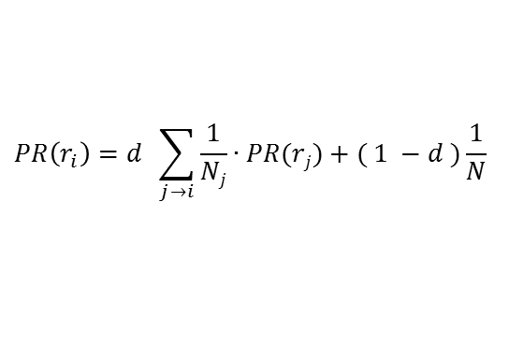
PageRank: Computation of Page Authority
PageRank score
Sum of previous page’s authority
Assumptions
Links often connect related pages
Links means a recommendation
Markov property
$$PR\left(r_{i}\right)=d \sum_{j→i}{\frac{1}{Nj}∙PR(rj)}+( 1 −d )\frac{1}{N}$$
Method for stochastic computation
page 1 authority score
page 2 authority score
Notes:
So the PageRank equation reflects two concepts.
One is the Markov property which means the current state is estimated based on the previous states.
And the other is the statistical concept mentioned in the previous slide.
Using the equation, PageRank computes a page’s authority.
The more in-links a page has, the higher its authority.

Slide 9

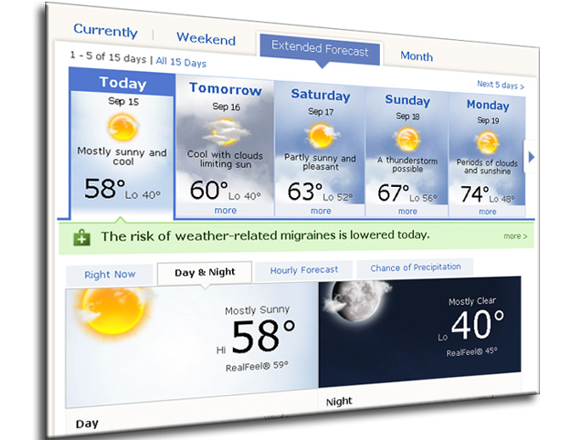
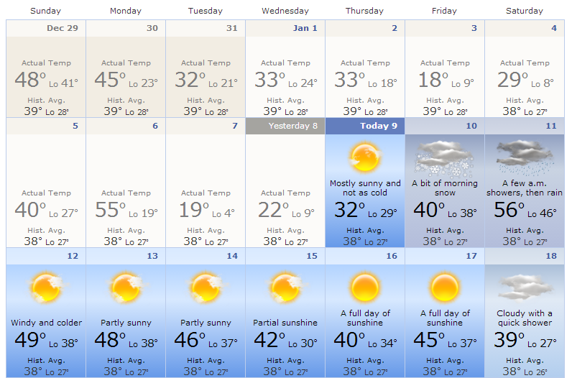
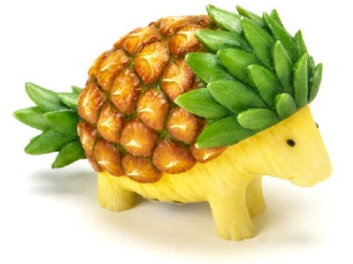
PageRank: Limitation
Distribute PageRank scores evenly
Undistinguishable importance of link
Weekly Forecast
Forecast
30
Monthly Forecast
30
30
AD
PR = 90
meaningless link
Notes:
But a problem arises from the fact that PageRank is unable to distinguish the importance of links
This page contains forecasting information.
Next two pages also contain forecasting information and the other page is just an advertising page.
However, a rank score of the previous page is equally distributed without considering the meaning of links.
Thus, to challenge the problem, further studies have tried to evaluate the importance of links.

Slide 10
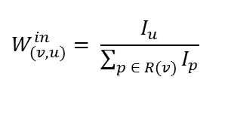
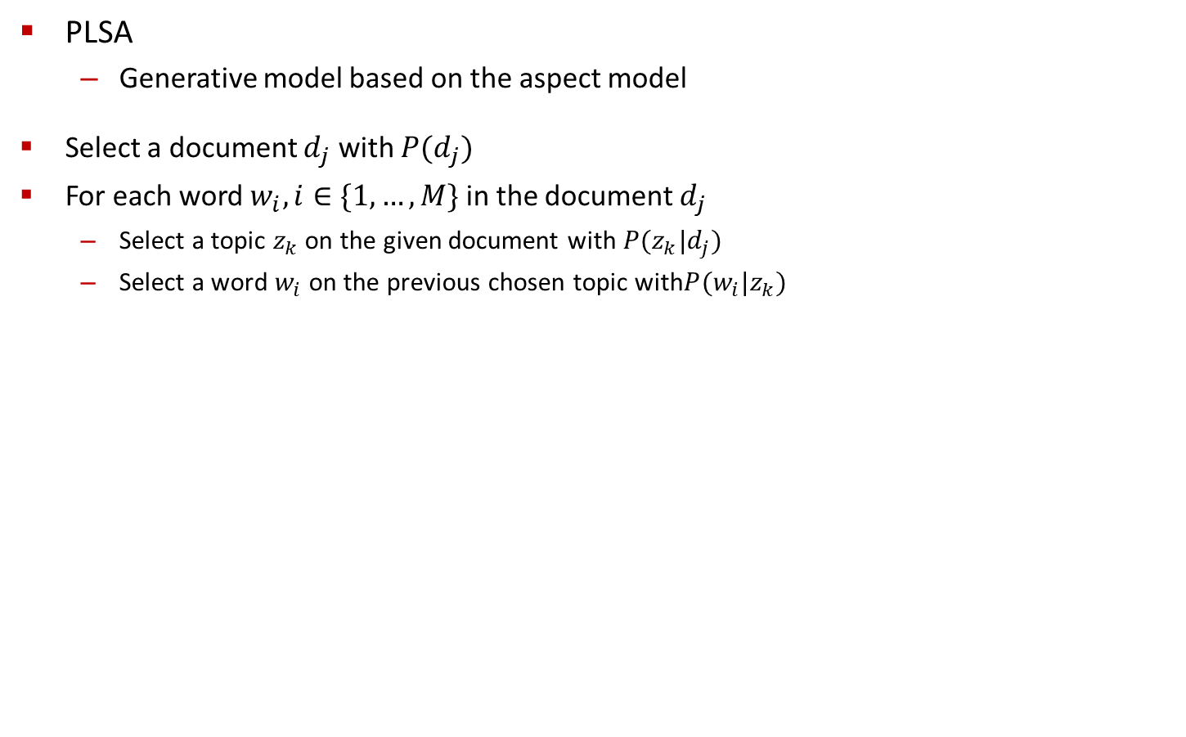
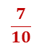
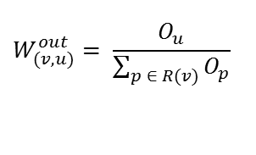
Weighted PageRank [Wenpu Xing et al., CNSR 2004]
Importance of link
measured by in-links and out-links:
Limitation
Algorithm is still based on the number of links
$$W_{(v, u)}^{in}= \frac{I_{u}}{\sum_{p ∈ R(v)}{I_{p}}}$$
$$W_{(v, u)}^{out}= \frac{O_{u}}{\sum_{p ∈ R(v)}{O_{p}}}$$
PR = 35
$$\frac{7}{10}$$
u
number of inlinks = 7
PR = 50
v
PR = 15
$$\frac{3}{10}$$
w
number of inlinks = 3
Notes:
This slide shows the concept of link weighting of PageRank.
Assume that page U has seven in-links and page W has three in-links.
Then page V distributes its rank value based on the number of the target pages’ in-links in proportion.
Remember that PageRank’s problem is
it only considers the number of links to compute a page’s importance.
The Weighted PageRank tries to evaluate the weight of links.
But, at the end of the day, this method still considers the number of links recursively to evaluate the weight of links.

Slide 11


Improvement of PageRank
Weighted Page Content PageRank
[SHARMA et al., IJEST 2010]
Improved weighted PageRank
Query-term matching based weighting
Topic-sensitive PageRank
[Taher Haveliwala, WWW 2002]
Utilize predefined topics
Provide query term relative ranking
Personalized PageRank
[G. Jeh et al., WWW 2003]
Biased Approach according to a user-specified set
Text Mining
Total Pages
Query ‘Health’
Query ‘Money’
Health Pages
Economic Pages
Notes:
Since the Weighted PageRank, many approaches have been provided to evaluate the weight of links more precisely.
For example, there are improved weighted PageRank with a text-based method,
or utilizing predefined topics for query term relative ranking, or user-specific ranking and so on.
But, topic at the Topic-sensitive PageRank is a general concept from heuristic works. It’s not relevant to topic model.

Slide 12



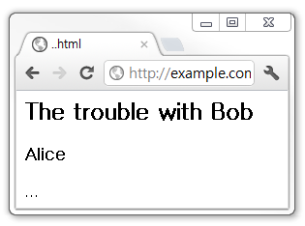
Web Semantic Metadata : RDFa
RDF based modeling language [W3C Working Group, WWW 2004]
Most extensible syntax
Used at Facebook, White House, BBC, Newsweek, Best Buy, Drupal…
RDF Triple
<div xmlns:dc=“http://purl.org/dc/elements/1.1/”>
<h2 property=“dc:title”>The trouble with Bob</h2>
<h3 property=“dc:creator”>Alice</h3>
...
</div>
Subject
Predicate
Object
HTML Parsing
http://www.exam.org/#friendOf
RDF Parsing
http://www.exam.org/life#dog
http://www.exam.org/life#human
http://example.com
/troubleWithBob
dc:title
dc:creator
The Trouble with Bob
Alice
Notes:
Buy the way, we can use RDFa for semantic metadata utilization.
RDFa is an RDF based modeling language.
RDF is a data model for semantic metadata. And the basic unit of RDF is a triple.
A Triple consists of a subject, a predicate[커트], and an object.
RDF can be used for building semantic information on the Web.
RDFa helps us to add RDF semantic data to the HTML code.
And then HTML code with RDFa can be viewed as a web page on the Web browser,
and we can use an RDF parser to extract semantic data, which we can use to improve PageRank performance.

Slide 13
Outline
Semantic PageRank
Introduction
Backgrounds
Semantic PageRank
Big Data Approach
Topic Model
Research Direction
Big Data Approach
Topic Model
Notes:
The second field of my research is about Big Data.
However, the main content of my presentation is topic model
So please allow me to skip the detailed explanation, but briefly mention the basis idea of Big Data (in this one page).

Slide 14
MapReduce Framework for Big Data
Hadoop MapReduce [J. Dean et al., OSDI 2004]
Programming model for large-scale data processing
Hadoop File System degrades performance
[J. Shafer et al., ISPASS 2010]
Must consider I/O cost
Hadoop Distributed File System
Map
sort and shuffle
Input
Reduce
Output
Map
sort and shuffle
Reduce
Map
Notes:
Hadoop framework distributes large datasets over multiple commodity servers and performs parallel computations.
Users can focus on implementing their algorithm at the map and reduce function with less considering parallel processing atmosphere.
However, multiple I/O operations have significant performance degradation factors.
An efficient MapReduce job must aim to minimize the number of I/O operations performed at each phase.
Thus, it’s important to optimize MapReduce algorithm considering I/O cost like using in-memory caches.

Slide 15
Outline
Semantic PageRank
Introduction
Backgrounds
Semantic PageRank
Big Data Approach
Topic Model
Research Direction
Big Data Approach
Topic Model
Notes:
Now, I’d like to introduce topic model and its representative methods.

Slide 16


Topic Model
Previous Approach
Vector Space Model [G. Salton et al., ACM 1975]
Limitation
Curse of dimensionality
Do not capture semantic relations
between words
Topic Model
Statistical model
To discover hidden topics in documents
Early topic model
Latent Semantic Indexing
[C. Papadimitriou et al., PODS 1998]
Polysemy
Synonymy
doc1 doc2 doc3 …
buy
big
quickly
purchase
large
speedily
term1
term2
term3
…
Term-document
matrix
Bank
topics
color color fruit
school school color
Notes:
Before the topic model, the vector space model has been widely used in the traditional Information Retrieval.
Many search engines used similarity measures based on the vector space model to rank Web pages.
A big term by document matrix is created where the columns represent Web documents and the rows represent terms.
However, vector space model could cause curse of dimensionality.
Moreover, because of considering the exact matching only, it is not good at dealing with synonymy and polysemy.
Synonymy means that there are many ways to refer to the same object.
Polysemy means that most words have more than one distinct meaning.
And usually, documents do not tell its topics explicitly.
For this reason, the study of topic model had been started.
An early topic model was described by a paper about Latent Semantic indexing in 1998.
In the topic model, topics consist of a cluster of words and have specific distributions over words.
Topic model utilizes this feature statistically and extracts latent topics from document sets.

Slide 17
Latent Semantic Analysis (LSA)
doc 1
"modem the steering linux. modem,
linux the modem. steering the modem. linux "
doc 2
"linux; the linux. the linux modem linux.
the modem, clutch the modem. petrol "
LSA [T. Landauer et al., discourse processes 1998]
Simulate human learning
Map documents and terms to a latent semantic space
Adopt a matrix decomposition method
doc 3
"petrol! clutch the steering, steering, linux. the
steering clutch petrol. clutch the petrol; the clutch "
doc 4
"the the the. clutch clutch clutch! steering petrol;
steering petrol petrol; steering petrol "
exposing latent
semantic
information
 | d1 | d2 | d3 | d4
d1 | 1 | 0.99 | 0.51 | 0.46
d2 | 0.99 | 1 | 0.58 | 0.54
d3 | 0.51 | 0.58 | 1 | 0.99
d4 | 0.46 | 0.54 | 0.99 | 1
document
similarity
X
X
 | linux | modem | clutch | steering | petrol
linux | 1 | 0.99 | 0.29 | 0.45 | 0.28
modem | 0.99 | 1 | 0.27 | 0.44 | 0.26
clutch | 0.29 | 0.27 | 1 | 0.98 | 0.99
steering | 0.45 | 0.44 | 0.98 | 1 | 0.98
petrol | 0.28 | 0.26 | 0.99 | 0.98 | 1
Term x Document
Term x Latent Semantic
Latent Semantic Space
Latent Semantic x Document
word
similarity
used for term analysis
used for doc. analysis
Notes:
Latent Semantic Analysis called LSA is a method for extracting and representing the contextual meaning of words.
In LSA, a term-document matrix is decomposed into three matrices.
Each matrix represents relationships with latent information.
Thus we can calculate similarity among terms or documents semantically.
This is a small example on LSA
We may notice that doc 1 and 2 belong to network related topic, and doc 3 and 4 belong to automobile related topic.
The result of term similarity analysis shows that LSA can also cluster terms with semantic meanings.
This example shows that although documents do not tell its topics explicitly,
Topic Model is able to extract latent topics and utilize topics for similarity analysis.

Slide 18
LSA: Singular Value Decomposition (SVD)
Eigendecomposition
Must be a diagonalizable and square matrix
A
P
Ʌ
P⁻¹
Singular Value Decomposition
Computable for any size (M x n) of matrix
A
U
∑
V^{T}
LSA
Adopt SVD to compute hidden value
X
X
Term x Document
Term x Latent Semantic
Latent Semantic Space
Latent Semantic x Document
Notes:
Now, let me discuss LSA computation from linear algebra point of view.
Technically, LSA adopts Singular Value Decomposition called SVD to extract latent information.
SVD is one of the most powerful and widely used tools in modern matrix computation. (early 70’s)
The SVD uses the eigendecomposition to derive a decomposition for rectangular matrices.
Using eigendecomposition, we can decompose the original matrix into three matrices.
But the original matrix must be a square matrix for eigendecomposition.
On the other hand, Singular Value Decomposition called SVD is a generalization of eigendecomposition.
Even if the original matrix is not a square matrix, SVD can decompose the matrix.
Using the SVD, LSA decomposes a term-document matrix into latent topics related matrices.

Slide 19



LSA: SVD Dimension Reduction
reduction with preserved significant information
Full SVD
Reduced SVD
More reduced SVD
Latent
Value
Term
Document
A
U
∑
V^{T}
100 x 100 100 x 100 100 x 20
A
U
∑
V^{T}
100 x 50 50 x 50 50 x 20
A
U
∑
V^{T}
100 x 10 10 x 10 10 x 20
Notes:
LSA using SVD can cut down the computational complexity by dimension reduction.
In the RHS of the equation,
we need the first matrix for analyzing terms and the third matrix for analyzing documents,
but the second matrix does not contain term or document information so we can reduce the size of the second matrix.
For an intuitive understanding, I added image compression examples using SVD on the right side of the slide.
It shows that dimension reduction of SVD preserves significant information.
Like this example, LSA with dimension reduction can analyze terms and documents with lower cost.

Slide 20
LSA: Discussion
Pros
Compute document similarity
Even if they do not have common words
Cons
Statistical foundation missing
Not elaborate enough for choosing latent values to reduction
given topic size = 4
unable to distinguish the
best set of reduced topics
reduced topic size = 2
topic1
topic2
topic ?
topic ?
topic3
topic4
Notes:
LSA performs better than the Vector Space Model
because LSA extracts latent semantic information and utilizes semantic values for analyzing documents.
However, LSA has some limitations.
LSA misses statistical information for words.
Thus it assumes normally distributed word data. But real term occurrence is not normally distributed.
Furthermore, for the dimension reduction process, there is no proper way to choose which dimension of topics would be remained.

Slide 21
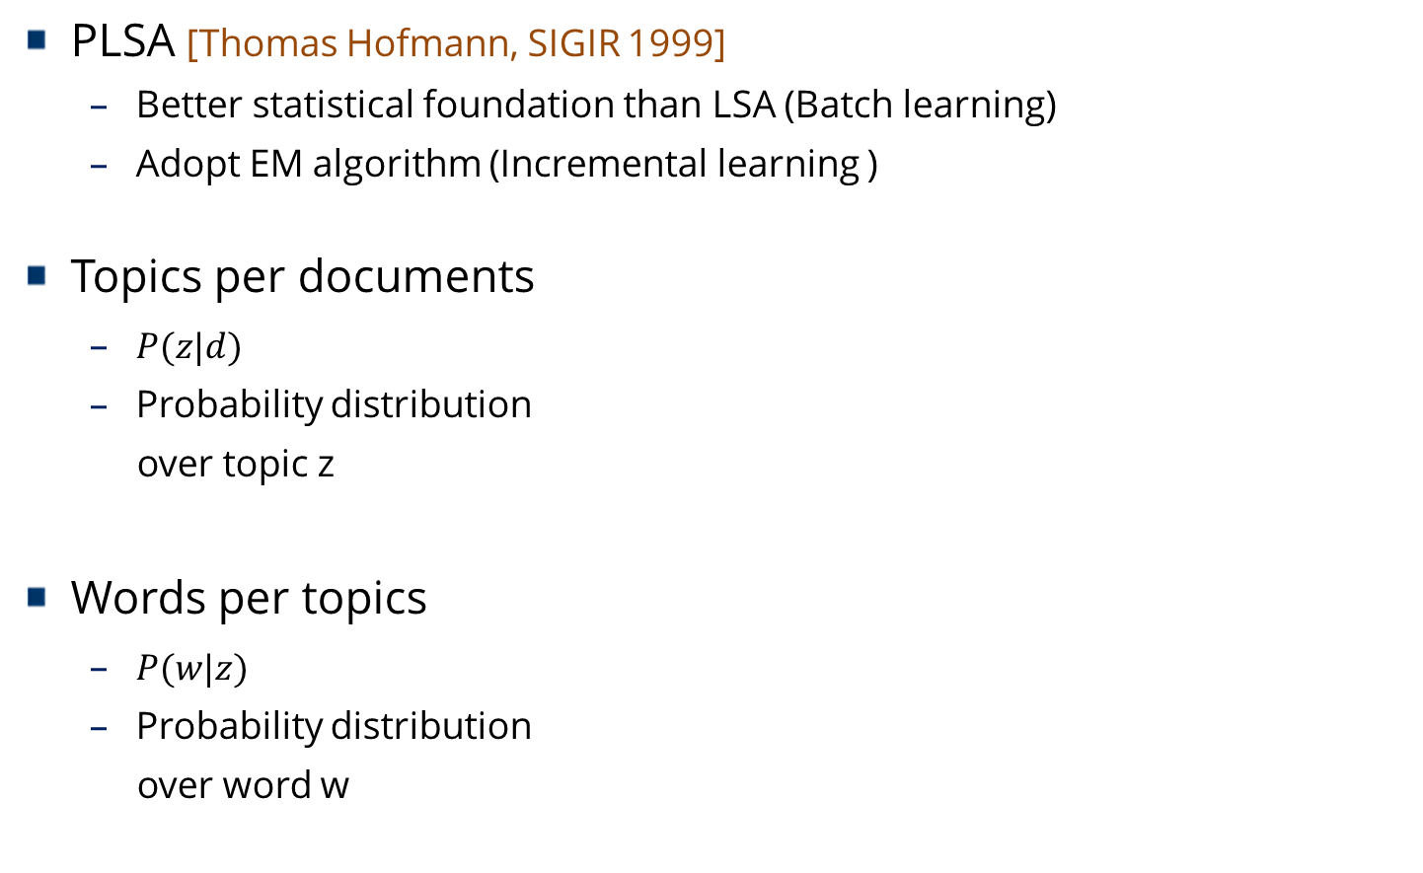
Probabilistic Latent Semantic Analysis (PLSA)
PLSA [Thomas Hofmann, SIGIR 1999]
Better statistical foundation than LSA (Batch learning)
Adopt EM algorithm (Incremental learning )
Topics per documents
$P(z|d)$
Probability distribution
over topic z
Words per topics
$P(w|z)$
Probability distribution
over word w
doc 1
doc 2
…
topics
topic 1
topic 2
…
words
Notes:
To improve the limitations of LSA, Probabilistic LSA called PLSA had been proposed.
PLSA lies on the basis of the theory of probability and stochastic process.
Unlike LSA, PLSA has distributions of topic per document,
and has distributions of words per topics.
In view of decomposition, LSA uses SVD to decompose a given term document matrix. It can be viewed as batch learning.
PLSA differs from LSA in that it uses an incremental learning based on the EM algorithm.
Probabilities of the word given topic and the topic given document are updated until the value converges.

Slide 22
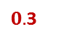
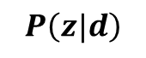
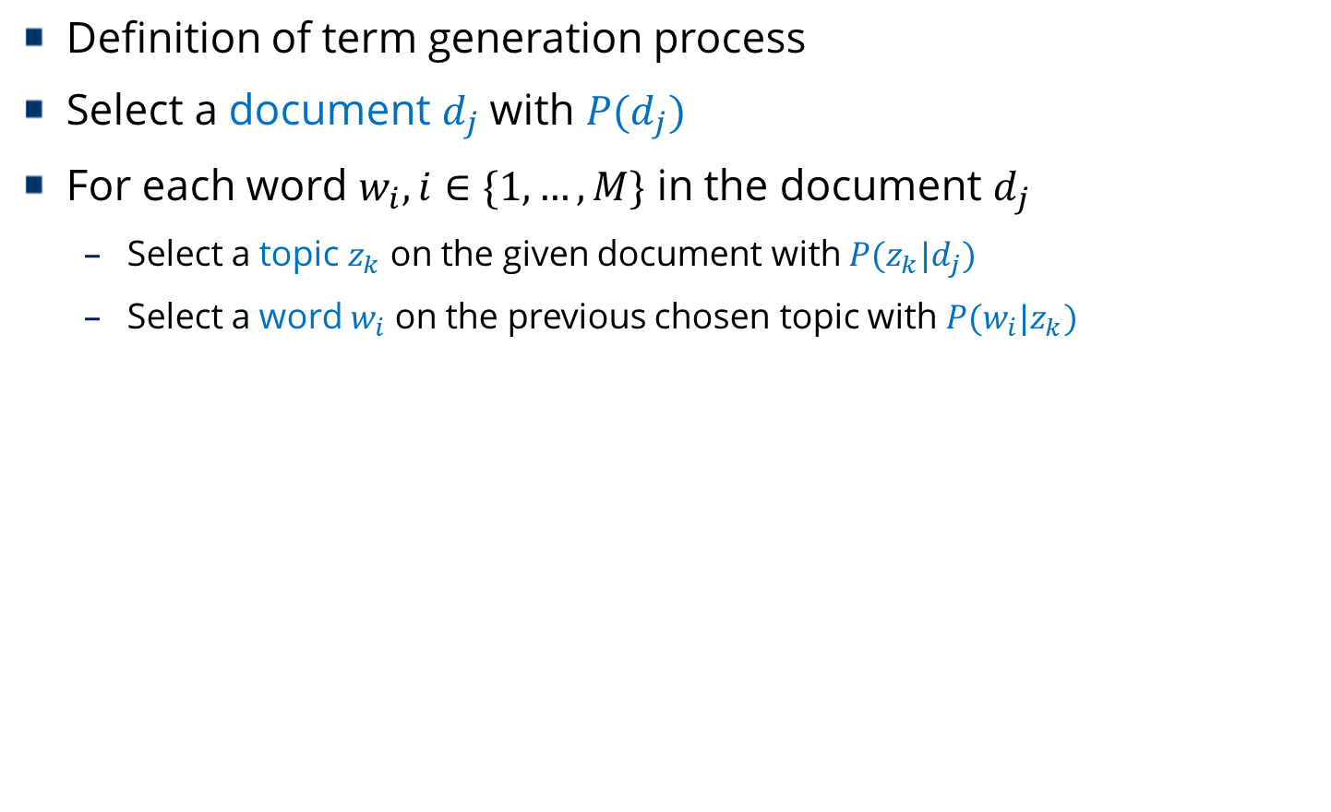
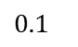
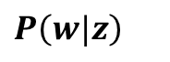
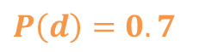
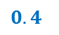
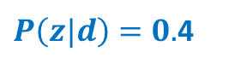
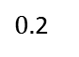
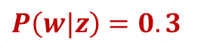
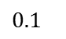
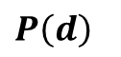
PLSA: Aspect Model
Definition of term generation process
Select a document $d_{j}$ with $P(d_{j})$
For each word $w_{i},i∈\{1,…,M\}$ in the document $d_{j}$
Select a topic $z_{k}$ on the given document with $P(z_{k}|d_{j})$
Select a word $w_{i}$ on the previous chosen topic with $P(w_{i}|z_{k})$
$$P\left(d\right)=0.7$$
$P\left(z|d\right)=0.$4
$$P\left(w|z\right)=0.3$$
documents
topics
words
$$P\left(d\right)$$
$$P\left(z|d\right)$$
$$P\left(w|z\right)$$
$$0.1$$
study
$$0.1$$
MS
$$0.4$$
company
apple
company
company
apple
company
apple
$0.$2
$0.$3
apple
sports
Notes:
PLSA takes aspect model for topic model processing.
There are three probabilities used in the model; P(d), P(z|d), and P(w|z)
Variable d is for document, z is for topic, and w is for word or term.
P(d) denotes the probability that a term occurrence will be observed in a particular document d
P(z|d) denotes the conditional probability over the topic given a document.
P(w|z) denotes the conditional probability over the word given a topic.
Aspect model defines the term generation process by the following steps.
First, select a document with P(d).
Second, select a topic with P(z|d).
Finally, select a word with P(w|z)

Slide 23
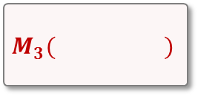
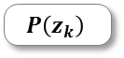
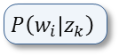
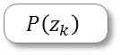


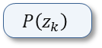
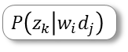

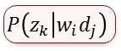
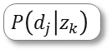
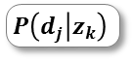
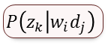
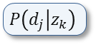
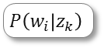
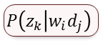
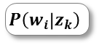
PLSA: EM Algorithm
PLSA: Aspect Model
0. Initialization
- Assign random values
d
z
w
$$P\left(z_{k}\right)$$
$$P\left(w_{i} | z_{k}\right)$$
$$P\left(d_{j} | z_{k}\right)$$
1. Expectation
- Expect likelihood
over target
probabilities
$$E\left( \right)$$
$$P\left(z_{k}\right)$$
$$P\left(w_{i} | z_{k}\right)$$
$$P\left(d_{j} | z_{k}\right)$$
Repeat
until
converge
$$P\left(z_{k} | w_{i}d_{j}\right)$$
2. Maximization
- Maximize
target
probabilities
$$M_{1}( )$$
$$M_{2}( )$$
$$M_{3}( )$$
$$P\left(z_{k} | w_{i}d_{j}\right)$$
$$P\left(z_{k} | w_{i}d_{j}\right)$$
$$P\left(z_{k} | w_{i}d_{j}\right)$$
$$P\left(z_{k}\right)$$
$$P\left(w_{i} | z_{k}\right)$$
$$P\left(d_{j} | z_{k}\right)$$
topic word per topic doc. per topic
Notes:
PLSA uses the EM algorithm to compute values mentioned in the previous slide.
It starts with randomly assigning values to all the parameters to be estimated
It then iteratively alternates between two steps, called the expectation step and the maximization step, respectively.
In the E-step, it computes the expected likelihood with regard to the conditional probabilities of the topics.
In the M-step, it re-estimates all the parameters.
Once we have newly calculated parameters, we can repeat the E step and M step with these parameters as the input data.
This process continues until the value converges.
http://times.cs.uiuc.edu/course/598f13/plsa-note.pdf
하늘색 240 245 250
연빨강 252 246 246

Slide 24
PLSA: Discussion
Generative model based on aspect model
LSA: selecting K singular values is heuristic
PLSA: keeping K aspects by statistical model
Significantly outperforms LSA
Extract topics by statistical calculation
Work for automated document indexing
Limitation
Overfitting problem
Notes:
PLSA improves LSA by using the aspect model,
and the model is calculated by EM algorithm.
While LSA has a debatable problem of dimension reduction,
PLSA can decide the dimension size of the latent values in early stage.
But the overfitting problem could arise because of the EM algorithm that runs a repetitive calculation until it converges.

Slide 25
Outline
Semantic PageRank
Introduction
Backgrounds
Semantic PageRank
Big Data Approach
Topic Model
Research Direction
Big Data Approach
Topic Model
Notes:
Finally, I will introduce my research direction.
As we have seen in the previous sections, there are three fields of my research;
Semantic PageRank, Big Data Approach, and Topic Model.
And I plan to build a system based on these fields.

Slide 26





Research Direction
1. Semantic Rank
→ Retrieval target information
zoom-out
2. Topic Model
→ Explore related theme
3. Big Data Approach
→ Large Data Computation
zoom-in
Notes:
First, to improve link-based ranking algorithm, I will utilize semantic information.
Second, to provide exploring system based on contents in the document
I will integrate topic model based approach into the ranking system.
Finally, I’m going to implement these frameworks using big data methods for dealing with large semantic and statistical data.
For this purpose, I have been studying these research fields, and some results of the study have been published.

Slide 27
Research Direction
Retrieval target information: Semantic Ranking
Hee-Gook Jun , Woo-Hyun Lee, Dong-Hyuk Im, Sang-goo Lee, and Hyoung-Joo Kim, "Weighted Semantic PageRank Using RDF Metadata on Hadoop," In Proceedings of the 2014 International Conference on Internet Computing and Big Data, 2014.
Hee-Gook Jun, Dong-Hyuk Im, Sang-goo Lee, and Hyoung-Joo Kim, "Improvement of PageRank Algorithm using Semantic Link," Journal of KIISE : Computing Practices and Letters, Vol. 18 (12), pp. 843-847, 2012.
Large Data Computation: Big Data Algorithm
Hee-Gook Jun et al., "Big Data Preprocessing for Predicting Box Office Success," Journal of KIISE : Computing Practices and Letters, Vol. 20 (12), pp. 615-622, 2014.
Explore related theme areas: Topic Modeling
Ongoing research
Semantic PageRank
Big Data Approach
Topic Model
Notes:
I have written two papers about ranking based on semantic data
and one paper about big data processing for an analysis.
And I plan to extend ranking algorithm by adopting topic model approaches.

Slide 28
Weighted Semantic PageRank
Goal
More reasonable page ranking using semantic information
Key ideas
RDF Resource contains semantic information
RDF Graph has labeled links
Web Page Level Rank
(page to page)
Semantic Level Rank
O
O
O
O
O
S
S
(information to information)
O
O
S
O
O
S
Notes:
In the current Web structure, links between pages are defined by Hyperlink notation.
Due to the fact that this notation does not have any way to express the meaning of links,
it is hard to evaluate the weight of links directly.
So I have planned to transform a hyperlinked Web structure to a semantic-linked Web structure using semantic metadata.
Once a semantic-linked Web structure is built,
we can directly evaluate the weight of links because-of semantically labeled links.

Slide 29
Research Plan
Utilize semantic information for PageRank
Large-scale data processing using MapReduce algorithm
Future Work
Adopt topic model method
MapReduce algorithm optimization
Semantic PageRank
Big Data Approach
PageRank
Important page has many inlinks
Topic Model
Weighted Semantic PageRank
Important page contains many
important resources
R
R
R
R
R
R
Notes:
Let me wrap up the main points of today’s talk.
PageRank is one of the most popular ranking algorithms.
But it has a limitation of not considering the meaning of links between pages.
So I plan to build Weighted Semantic PageRank that can directly evaluate the weight of links.
And I will adopt topic model methods for better semantic analysis
and optimize MapReduce algorithm.
This concludes my presentation. Thank you for your attention.

Slide 30
References
Topic model
MPS Bhatia et al., "Paradigm shifts: from pre-web information systems to recent web-based contextual information retrieval," Webology, Vol. 7 (1), 2010.
C. Papadimitriou et al., "Latent Semantic Indexing: A probabilistic analysis,". Proceedings of ACM PODS, 1998.
M. Steyvers and T. Griffiths, "Probabilistic topic models," Handbook of LSA, Vol. 427 (7), pp. 424-440, 2007.
D. Cai et al., "Modeling hidden topics on document manifold," In Proceedings of the 17th ACM conference on Information and knowledge management, pp. 911-920, 2008.
G. Salton et al., "A Vector Space Model for Automatic Indexing," Comm. of the ACM, Vol. 18 (11), pp. 613-620, 1975.
Raghavan et al., "A critical analysis of vector space model for information retrieval," Journal of the American Society for information Science, Vol. 37 (5), pp. 279-287, 1986.
G. H. Golub et al., "Calculating the singular values and pseudo-inverse of a matrix," Journal of the Society for Industrial and Applied Mathematics: Series B, Numerical Analysis, Vol. 2 (2), pp. 205-224, 1965.
K. Baker, "Singular value decomposition tutorial," The Ohio State University, pp. 1-24, 2005.
Dumais et al., "Latent semantic analysis," Annual review of info. science and tech., Vol. 38 (1), pp. 188-230, 2004.
S. Deerwester et al., "Indexing by latent semantic analysis," JASIST, Vol. 41 (6), pp. 391-407, 1990.
T. K. Landauer et al.. "An introduction to latent semantic analysis," Discourse processes, Vol. 25 (2-3), pp. 259-284, 1998.
T. Hofmann, "Probabilistic Latent Semantic Indexing," Proceedings of the Twenty-Second Annual International SIGIR Conference on Research and Development in Information Retrieval, pp. 50-57, 1999.
A. Singh, "Survey on pLSA based scene classification techniques," Conf. The Next Gen. Info. Tech., pp. 555-560, 2014.
L. Hong, "A Tutorial on Probabilistic Latent Semantic Analysis"
J.M. Marin, K. Mengersen, and C.P. Robert, "Bayesian modelling and inference on mixtures of distributions," In Dey, D. & Rao, C.R. (Eds.) Handbook of Statistics, Vol. 25, 2011.

Slide 31
References
Semantic PageRank
S. Brin and L. Page. , "The Anatomy of a Large-scale Hypertextual Web Search Engine," Computer Networks and ISDN Systems, Vol. 30 (1-7), pp. 107-117, 1998.
Markov A.A., "Extension of the limit theorems of probability theory to a sum of variables connected in a chain," John Wiley and Sons, 1971.
Wenpu Xing et al., “Weighted PageRank Algorithm”, Proceedings of the second annual conference on Communication Networks and Services Research (CNSR), IEEE, 2004.
SHARMA et al., "Weighted Page Content Rank for Ordering Web Search Result", International Journal of Engineering Science and Technology, Vol 2 (12), pp. 7301-7310, 2010.
Taher Haveliwala, "Topic-sensitive PageRank," In proceedings of the 11th international conference on World Wide Web, pp. 517-526, 2002.
Glen Jeh and Jennifer Widom, "Scaling Personalized Web Search," In proceedings of the 12th international conference on World Wide Web, pp. 271-279, 2003.
W3C Working Group, "RDFa Core 1.1 - Second Edition," Available from: http://www.w3.org/TR/rdfa-syntax/
Big Data
J. Dean and S. Ghemawat. "Mapreduce: Simplified data processing on large clusters," In Proceedings of the 6th USENIX Symposium on Opearting Systems Design & Implementation (OSDI), pp. 137-150, 2004.
J. Shafer and S. Rixner, "The Hadoop distributed filesystem: Balancing portability and performance," Performance Analysis of Systems & Software (ISPASS), 2010 IEEE International Symposium on. IEEE, 2010.
G. Ananthanarayanan, Ganesh et al. "PACMan: coordinated memory caching for parallel jobs," Proceedings of the 9th USENIX conference on Networked Systems Design and Implementation. USENIX Association, 2012.
J. Zhang et al. "A distributed cache for hadoop distributed file system in real-time cloud services," Grid Computing (GRID), 2012 ACM/IEEE 13th International Conference on. IEEE, 2012.
K.Senthikumar, K. Satheesahkumar, S. Chandraskaran., "Performance Enhancement of Data Processing using Multiple Intelligent Cache in Hadoop," In International Journal of Information and Education Technology, 2014.

Slide 32
Thank you

Slide 33
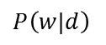
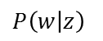
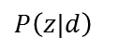
PLSA vs. LSA: Matrix Decomposition
Batch Learning (SVD)
n
r
r
n
LSA
m
A
m
U
r
∑
r
V^{T}
Word per topic
Topic space
Topic per document
Incremental Learning (EM)
doc n
r
n
PLSA
word m
m
r
$$P\left(w|d\right)$$
$$P\left(w | z\right)$$
$$P\left(z|d\right)$$
Observed word
distributions
Word distributions
per topic
Topic distributions
per document
Notes:
In view of decomposition, LSA uses SVD to decompose a given term document matrix. It can be viewed as batch learning.
PLSA differs from LSA in that it uses an incremental learning based on the EM algorithm.
Probabilities of the word given topic and the topic given document are updated until the value converges.

Slide 34
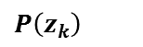
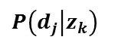
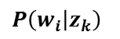
PLSA: Example
doc 1
"modem the steering linux. modem,
linux the modem. steering the modem. linux "
doc 2
"linux; the linux. the linux modem linux.
the modem, clutch the modem. petrol "
doc 3
"petrol! clutch the steering, steering, linux. the
steering clutch petrol. clutch the petrol; the clutch "
doc 4
"the the the. clutch clutch clutch! steering petrol;
steering petrol petrol; steering petrol "
topic
 | dim1
topic1 | 0.35
topic2 | 0.65
$$P\left(z_{k}\right)$$
doc. per topic
 | d1 | d2 | d3 | d4
topic1 | 0.00 | 0.09 | 0.47 | 0.44
topic2 | 0.46 | 0.40 | 0.07 | 0.06
$$P\left(d_{j} | z_{k}\right)$$
word per topic
 | linux | modem | the | clutch | steering | petrol
topic1 | 0.00 | 0.00 | 0.23 | 0.28 | 0.19 | 0.28
topic2 | 0.31 | 0.31 | 0.29 | 0.00 | 0.09 | 0.00
$$P\left(w_{i} | z_{k}\right)$$
Notes:
This slide shows a small example on PLSA.
For this example, the number of topics is set as two.
We may notice that doc 1 and 2 belong to network related topic, and doc 3 and 4 belong to automobile related topic.
The result of term similarity analysis shows that LSA can also cluster terms with semantic meanings.
Buy the way, we can see some probabilities are zero.
It is because of the EM algorithm that runs a repetitive calculation until it converges.
But the overfitting problem could arise from this feature.

Slide 35


Latent Dirichlet Allocation (LDA)
Generative probabilistic model [D. Blei, JMLR 2003]
Documents are represented as random mixtures over latent topics
Topics characterized by a distribution over words
LDA vs. PLSA
PLSA: provides no probabilistic model at the level of documents
LDA: provides generative model for document (mixture of topics)
β
Topic
$$Φ$$
K: # of topics
Document
LDA
Word
𝛼
$θ$
Z
W
PLSA
N_{d}: # of words in doc d
M: # of documents
Notes:
David Blei offered LDA as an alternative of PLSA.
LDA has more statistical assumptions at the document level.
PLSA uses the aspect model to define term generation.
But it provides no probabilistic model at the document level.
LDA extends the aspect model and provides more strict generative model.

Slide 36

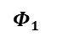
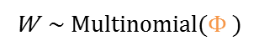
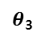
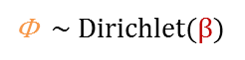
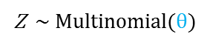
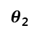
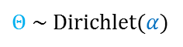
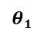

LDA: Generative Model
doc1
doc2
doc3
words
words
words
red blue apple
book study black
grape melon apple
MS math black white
EA GE apple
MS science pink
topics
topics
topics
color color fruit
school school color
fruit fruit fruit
company school color color
company company
company
company school color
$$θ1$$
$θ$₂
$θ$₃
W ~ Multinomial($\text{Φ} )$
Z ~ Multinomial($θ)$
β
Topic
$$Φ$$
$\text{Φ}$ ~ Dirichlet($β$)
$$Φ1$$
$$Φ2$$
$\text{Θ}$~ Dirichlet($α$)
K: # of topics
Document
Word
𝛼
$θ$
Z
W
N_{d}: # of words in doc d
M: # of documents
Notes:
LDA adopts the generative model to define term generation process.
Each document has its topic distribution. Each topic also has its word distribution.
LDA defines a word generation using document to topic and topic to word conditional probability with a hyperparameter alpha. It’s similar to PLSA.
But additionally, LDA uses topic distribution over words with another hyperparameter beta.
Multinomial distribution is used for expressing distributions of topics per document.
And dirichlet distribution is used for expressing distributions of probabilities of topics.
Another Multinomial distribution is also used for expressing distributions of words per topic
And dirichlet distribution is also used for expressing distributions of probabilities of words.

Slide 37
LDA: Discussion
LDA
Improves PLSA with more strict statistical model
Equivalence between LDA and PLSA[M. Girolami et al., SIGIR 2003]
Maximum a posteriori estimated LDA model
Under a uniform Dirichlet prior
Perceived shortcomings of PLSA
Can be resolved and elucidated within the LDA framework
Notes:
LDA is a more statistically strict model than PLSA.
Because LDA deals with parameters and hyperparameters while PLSA deals with parameters.
This feature enables LDA to control analysis more specifically.
But under a uniform prior distribution, it is proved that PLSA is same as LDA.
For machines, it is usual to have no prior knowledge about newly crawled web pages.
In this condition, results of PLSA would show a similar quality to the results of LDA.

Slide 38
Basis Theories of LDA
Probability theory
Binomial and Beta distribution
Bayesian inference with conjugate prior*
Multinomial and Dirichlet distribution**
Statistic simulation method
Markov Chain Monte Carlo⁺
Gibbs sampling⁺⁺
* | M. Farrow, MAS3301 Bayesian Statistics, Newcastle University. 2013. Available from: http://www.mas.ncl.ac.uk/~nmf16/teaching/mas3301/week3.pdf [Accessed: 7 May 2015].
** | B. A. Frigyik, A. Kapila, and M. a R. Gupta. Introduction to the Dirichlet Distribution and Related Processes, University of Washington Department of Electrical Engineering, 2012.
+ | Markov A.A., "Extension of the limit theorems of probability theory to a sum of variables connected in a chain," John Wiley and Sons, 1971.
++ | C. Andrieu, N. D. Freitas, and A. Doucet, An Introduction to MCMC for Machine Learning, 2003.
Notes:
Due to the fact that LDA is a strict statistical model, the theory of LDA consists of probability methods and statistical simulation methods.

Slide 39







LDA Theories [1/4]: Binomial and Beta Distribution
Binomial distribution
Random variable: X = # of successes in n trials
Parameter: n (# of trials), p (success probability in each trial)
Beta distribution
The domain of the beta dist. can be viewed as a probability
Often used to describe the distribution of a probability value p
$$f\left(x;n, p\right)=P\left(X=x\right)=\left(\begin{matrix}n \\ x\end{matrix}\right)p^{x}{(1−p)}^{n−x}$$
Tail
Head
Tail
Head
Tail
Head
p < 0.5 skewed left
p = 0.5 symmetric
p > 0.5 skewed right
$$X\sim Bin\left(n,p\right) \text{P} \sim Beta(α,β)$$
Notes:
In the Binomial coin experiment, if given probability is 50 percent, then the number of tail and the number of head is almost equal.
if given probability is 10% percent, then the number of tail is greater than that of head.
Thus, the probability of binomial distribution has a distribution itself.
Beta distribution is a good model to fit the distribution of the probability.
in order words, Binomial distribution is a function of parameters and Beta distribution is a function of hyperparameters.
hyperparameter means a parameter of the parameter.
http://www.arachnoid.com/binomial_probability/index.html
http://en.wikipedia.org/wiki/Beta_distribution

Slide 40






LDA Theories [2/4]: Bayesian Inference with Conjugate Prior
Posterior probability
Consequence of two antecedents
Prior probability and Likelihood function
Mixture of two distributions generates a new distribution
likelihood x prior
posterior
$$p\left(x | θ\right) × p(θ)$$
$$p\left(θ|x\right)$$
likelihood
prior
posterior
Conjugate prior
Posterior distributions are in the same family as the prior probability distribution
Binomial Dist.
Beta Dist.
Beta Dist.
likelihood
conjugate prior
posterior
same distribution
Notes:
Binomial and beta distribution have special relationships with each other in Bayesian inference.
Generally, a mixture of distributions creates a new distribution.
But the mixture of Binomial and beta distribution recursively generates beta distribution again.
It’s an important feature for recursive computation with low complexity.

Slide 41





LDA Theories [3/4]: Binomial Dist. vs. Multinomial Dist.
Multinomial dist. is a generalization of the binomial dist.
Binomial distribution
$$f\left(x;n, p\right)=\left(\begin{matrix}n \\ x\end{matrix}\right)p^{x}{(1−p)}^{n−x}$$
T F T T F F F T F T
$$\left(\begin{matrix}10 \\ 5\end{matrix}\right)p^{5}{(1−p)}^{10−5}$$
Multinomial distribution
$f\left(x_{1},{…,x}_{k};n,p_{1},{…,p}_{k}\right)=\frac{n!}{x_{1}!{…x}_{k}!}{p_{1}}^{x_{1}}$…${p_{k}}^{x_{k}}$
$$⇧ ⇩ ⇧ ⇧ ⇩ ⇦ ⇧ ⇩ ⇨ ⇧ ⇦ ⇩$$
$$\frac{10!}{5!4!2!1!}{p_{1}}^{5}{p_{2}}^{4}{p_{3}}^{2}{p_{4}}^{1}$$
Notes:
Multinomial Distribution is a generalization of Binomial Distribution. It is used in both PLSA and LDA.

Slide 42





LDA Theories [4/4]: Beta Dist. vs. Dirichlet Dist.
Dirichlet dist. is a multivariate generalization of the Beta dist.
Very often used as prior distributions in Bayesian Statistics
Conjugate prior of the Multinomial dist.
$$X\sim Bin\left(n,θ\right)$$
$$\text{Θ} \sim Beta(α,β)$$
$$X_{1},…,X_{k}\sim Multi\left(n,θ_{1},…,θ_{k}\right)$$
$${\text{Θ}}_{1} ,…,{\text{Θ}}_{k}\sim Dir\left(α_{1},…,α_{k}\right)$$
Posterior = Likelihood x Conjugate prior
$$p\left(θ | x,α\right)=p(x|θ)×p(θ)$$
$$\frac{1}{Beta(x+α)}\prod_{i=1}^{|α|}{{θ_{i}}^{{x_{i}+α}_{i}−1}}=\left\{\frac{n!}{\prod_{i=1}^{K}{x_{i}!}}\prod_{i=1}^{K}{{θ_{i}}^{x_{i}}}\right\} × \left\{\frac{1}{Beta(α)}\prod_{i=1}^{|α|}{{θ_{i}}^{α_{i}−1}}\right\}$$
Notes:
But Dirichlet Distribution is used in LDA but not in PLSA.
As Multinomial is a generalization of Binomial, Dirichlet Distribution is a generalization of Beta Distribution.

Slide 43







LDA Calculation: Markov Chain Monte Carlo
Deterministic system
Non-deterministic system: Markov Chain
Memorylessness and random state-transition model
Assumption: Next state depends only on the current state
spring
summer
fall
winter
$Pr⁡(X_{n+1}=x |{ X}_{n}=x_{n},…,X_{1}=x_{1})$ = $Pr⁡(X_{n+1}=x |{ X}_{n}=x_{n})$
Notes:
PLSA uses EM algorithm to compute values. But LDA has much more parameters than PLSA.
Thus PLSA usually adopts Markov Chain Monte Carlo called MCMC.
Markov Chain is an estimation model in non-deterministic system.

Slide 44
LDA Calculation: Markov Chain Monte Carlo Cont.
Sampling from a probability distribution
Based on constructing a Markov Chain
Based on the random variable (Monte Carlo simulation)
The state of the chain after a number of steps
Used a s a sample of the desired distribution
The number of steps
Improves the quality of the sample
Notes:
And Monte Carlo means it’s a statistical method to solve problems with replacing unknown functions into well-known distribution functions.

Slide 45





LDA Practical Calculation: Gibbs Sampling
MCMC algorithm
For obtaining a sequence of observations
Approximated from a specified multivariate probability distribution
Generate a Markov chain of samples
Samples from the beginning of the chain
May not accurately represent the desired distribution
$$X\sim N\left(μ,σ^{2}\right)$$
Finding distribution parameters using Gibbs sampling
Notes:
Gibbs sampling is one of the practical methods for MCMC.
Under a specific condition, it guarantees a simple calculation complexity than other MCMC methods to find an answer.

Slide 46




LDA: Experiments*
$\text{Φ}$: word distribution per topic
Appropriate assignments of words to topics are discovered
log P(w|z)
$${\text{Φ}}_{k}$$
Iteration
* | Yi Wang, Distributed Gibbs Sampling of Latent Topic Models: The Gritty Details, 2008. Available from: https://cxwangyi.files.wordpress.com/2012/01/llt.pdf [Accessed: 7 May 2015].
Notes:
This figure shows that LDA using Gibbs sampling.
Boxes are documents with various topics.
After Gibbs sampling, we can see topics in documents are converged in specific topics.

Slide 47
LSA: Example
Document similarity
Term similarity
doc 1
doc 2
doc 3
doc 4
modem the steering linux. modem,
linux the modem. steering the modem. linux
 | d1 | d2 | d3 | d4
d1 | 1 | 0.99 | 0.51 | 0.46
d2 | 0.99 | 1 | 0.58 | 0.54
d3 | 0.51 | 0.58 | 1 | 0.99
d4 | 0.46 | 0.54 | 0.99 | 1
linux; the linux. the linux modem linux.
the modem, clutch the modem. petrol
petrol! clutch the steering, steering, linux.
the steering clutch petrol. clutch the petrol; the clutch
the the the. clutch clutch clutch! steering petrol;
steering petrol petrol; steering petrol
linux | modem the
modem | linux the
the | linux modem clutch steering petrol
clutch | the steering petrol
steering | the clutch petrol
petrol | the clutch steering
 | t1 | t2 | t3 | t4 | t5 | t6
t1 | 1 | 0.99 | 0.80 | 0.29 | 0.45 | 0.28
t2 | 0.99 | 1.00 | 0.79 | 0.27 | 0.44 | 0.26
t3 | 0.80 | 0.79 | 1 | 0.80 | 0.89 | 0.79
t4 | 0.29 | 0.27 | 0.80 | 1 | 0.98 | 0.99
t5 | 0.45 | 0.44 | 0.89 | 0.98 | 1 | 0.98
t6 | 0.28 | 0.26 | 0.79 | 0.99 | 0.98 | 1
Notes:
This slide shows a small example on LSA.
There are 4 documents for similarity analysis with LSA.
LSA binds document 1 and document 2 together, and binds document 3 and document 4.
We can see document 1 and 2 mainly contain Network related topics,
and document 3 and 4 contain automobile related topics.
The result of term similarity analysis shows that LSA can also cluster terms with semantic meanings.

Slide 48





LSA: Terminologies on Matrix Theory
Eigenvector ( $\vec{v}$ )
Nonzero vector that satisfies the equation $A\vec{v}=λ\vec{v}$
A is a square matrix
Eigenvalue ( $λ$ )
A number associated with the eigenvector $\vec{v}$
$$A\vec{v}=λ\vec{v}$$
$$A\vec{v}=λ\vec{v}= \left[\begin{matrix}11 & 1 \\ 1 & 11\end{matrix}\right]\left[\begin{matrix}x_{1} \\ x_{2}\end{matrix}\right]=λ\left[\begin{matrix}x_{1} \\ x_{2}\end{matrix}\right] ≡ \begin{matrix}11x_{1}+x_{2}=λx_{1} \\ x_{1}+11x_{2}=λx_{2}\end{matrix}$$
Calculated eigenvalues
$$\left|\begin{matrix}(11−λ) & 1 \\ 1 & (11−λ)\end{matrix}\right|=0$$
$$λ=10,λ=12$$
Notes:
For better understanding of eigendecomposition, I’m going to share the fundamental matrix theories, briefly.
In linear algebra, if v is a non-zero vector, then it is an eigenvector of a square matrix A when Av is a scalar multiple of v.
And the scalar value lambda is called as the eigenvalue associated with the eigenvector v.
These concepts are directly used in eigendecomposition.

Slide 49






PLSA: Fundamental Theory
Likelihood
Given B, probability of the A?
P( A I B )
Maximum Likelihood
Given B, which one gives the highest probability?
$\begin{matrix}Argmax P\left( A \right|B ) \\ a ∈A \end{matrix}$
Likelihood
Observation
1/4
Probability
Result
1/4
4
1/6
4
1/6
1/6
4
Maximum Likelihood
4
1/12
4
1/12
1/12
4
$$ML=MAP (in a specific assumption)$$
$\begin{matrix}argmax P\left( A \right| B ) \\ a ∈A \end{matrix}$= $\begin{matrix}argmax \frac{P\left( B \right| A )P(A)}{P(B)} \\ a ∈A \end{matrix}$=$\begin{matrix}argmax P\left( B \right| A ) \\ a ∈A \end{matrix}$
$$maximum a ⇔ \frac{∂P(B|A)}{∂a}=0$$
Notes:
PLSA uses the EM algorithm to compute values mentioned in the previous slide.
This slide shows the statistic inference concepts for better understanding of EM algorithm.
Likelihood can be viewed as the other side of the probability.
Probability is to know what the result of the given event is.
On the other hand, Likelihood is in reverse direction of probability.
Likelihood is a measurement to represent the degree of potential to get the given result.
In this example 4-sided dice has the maximum likelihood to get the given result four.
In finding Maximum likelihood, if priori probability has an uniform distribution, ML is same as Maximum a posteriori,
Priori and posteriori are terminologies from Bayesian inference.
In Bayesian inference, posteriori prob. can be inference by the priori probability.
Maximum a posteriori is to solve the probability of data with lower computation complexity than ML.
Then finding the maximum value can be acquired by differentiation of the equation.

Slide 50

PLSA: EM Algorithm*
Expectation
$P\left(z_{k} | w_{i}d_{j}\right)=\frac{P(w_{i}|z_{k})P(d_{j}|z_{k})P(z_{k})}{\sum_{k=1}^{K}{P(w|z_{k})P(d|z_{k})P(z_{k})}}$
Maximization
$P\left(z_{k}\right)=\frac{\sum_{i=1}^{M}{\sum_{j=1}^{N}{n(w_{i},d_{j})P(z_{k}|w_{i}d_{j})}}}{\sum_{i=1}^{M}{\sum_{j=1}^{N}{n(w_{i},d_{j}) }}}$
$P\left(w_{i} | z_{k}\right)=\frac{\sum_{j=1}^{N}{n(w_{i},d_{j})P(z_{k}|w_{i}d_{j})}}{\sum_{i=1}^{M}{\sum_{j=1}^{N}{n(w_{i},d_{j})P(z_{k}|w_{i}d_{j})}}}$
$P\left(d_{j} | z_{k}\right)=\frac{\sum_{i=1}^{M}{n(w_{i},d_{j})P(z_{k}|w_{i}d_{j})}}{\sum_{j=1}^{N}{\sum_{i=1}^{M}{n(w_{i},d_{j})P(z_{k}|w_{i}d_{j})}}}$
* | L. Hong, "A Tutorial on Probabilistic Latent Semantic Analysis," available form: http://arxiv.org/pdf/1212.3900.pdf [Accessed: 7 May 2015]. J.M. Marin, K. Mengersen, and C.P. Robert, "Bayesian modelling and inference on mixtures of distributions," In Dey, D. & Rao, C.R. (Eds.) Handbook of Statistics, Vol. 25, 2011.
Notes:
PLSA uses the EM algorithm to compute values mentioned in the previous slide.
빨간색 (RGB 150 20 20)
파란색 (RGB 5 50 150)

Slide 51
Bag-of-Words
Assumes order of words has no significance
e.g., the term “home made” has the same probability as “made home”
It is a simplifying assumption used in natural language processing and information retrieval
Notes:
The bag-of-words is a simplifying representation used in natural language processing and information retrieval.
In this model, a document is represented as the bag of its words, disregarding grammar and even words order but keeping multiplicity.
The bag-of-words model is commonly used in methods of document classification, where the occurrence of each word is used as a feature for training a classifier.

Slide 52
Topic Model for Information Retrieval
Topic Model for IR
J.M. Ponte and W.B. Croft, "A language modeling approach to information retrieval," In Proceedings of the 21st Annual International ACM SIGIR Conference on Research andDevelopment in Information Retrieval, pp. 275-281, 1998.
C. Zhai and J. Lafferty, "A study of smoothing methods for language models applied to ad hoc information retrieval," In Proceedings of the 24th Annual International ACM SIGIR Conference on Research and Development in Information Retrieval, pp. 334-342, 2001.
M. Steyvers, P. Smyth, and T. Griffiths, "Probabilistic author-topic models for information discovery," In Proceeding of the 10th ACM SIGKDD conference on knowledge discovery and data mining, pp. 306-315, 2004.
L. Nie, B.D. Davison, and X. Qi, "Topical link analysis for web search," In Proceedings of the 29th Annual International ACM SIGIR Conference on Research and Development in Information Retrieval, pp. 91-98, 2006.
Topic-Based Ranking
S.K.Pal and B. Narayan, "A web surfer model incorporating topic continuity," IEEE Transactions on Knowledge and Data Engineering, Vol. 17, pp. 726-729, 2005.
J. Tang, R. Jin, and J. Zhang, "A topic modeling approach and its integration into the random walk framework for academic search," In Proceedings of 2008 IEEE International Conference on Data Mining (ICDM2008), pp. 1055-1060), 2008.
Z. Yang, J. Tang, , Zhang, J. and J. Li, "Topic-level random walk through probabilistic model," In Proceedings of Joint International Conferences of APWeb/WAIM, pp. 162-173), 2009.
D. Duan et al, "RankTopic: Ranking Based Topic Modeling," ICDM. 2012.
Social Network
Weng, Jianshu, et al. "Twitterrank: finding topic-sensitive influential twitterers," Proceedings of the third ACM international conference on Web search and data mining. ACM, 2010.
Author Citation Network
Ding, Ying. "Topic-based PageRank on author cocitation networks," Journal of the American Society for Information Science and Technology, Vol. 62 (3), pp. 449-466, 2011.

Slide 53






Text-based Retrieval Method
Fundamental Approaches for Web information retrieval
Similarity**
Web document
Vector Space Model*
$$sim\left(A,B\right)=\cos\left(θ\right)=\frac{A∙B}{\left\|A\right\|\left\|B\right\|}$$
(1, 1, 1, 1)
$$θ$$
page1
(0, 1, 0, 0)
page2
Term frequency***
page3
(1, 1, 1, 0)
$$w_{x,y}={tf}_{x,y}×\log{(\frac{N}{{df}_{x}})}$$
${tf}_{x,y}$ = frequency of x in y
Term x within document y
${df}_{x}$ = number of documents containing x
$N$ = total number of documents
* | Salton G. et al., "A Vector Space Model for Automatic Indexing," Communications of the ACM, vol. 18 (11), pp. 613–620, 1975.
** | Roberto J. Bayardo et al., “Scaling up all Pairs Similarity Search”, Proceedings of the 16th international conference on World Wide Web, pp. 131-140, 2007.
*** | Salton G. and Buckley C., "Term-weighting approaches in automatic text retrieval," Information Processing and Management, vol. 24 (5), pp. 513–523, 1988.
Notes:
One of the fundamental approaches for retrieving Web data is text-based retrieval.
We can use the Vector Space Model to change Web contents to a set of vectors.
And then we can do some linear algebra calculation using Cosine similarity, TF-IDF, etc. [et cetera]

Slide 54








Text-based Retrieval Method: Problems
Unexpected search result
Misuse or abuse
Hidden text to advertise
Obama care
False positive results
Obama,US
President
Obama,US
President
Obama,US
President
Obama,US
President
Child
Care
ACA
Insurance
Shopping Mall
Most visited site
Best-product
High-quality
…
Notes:
However, simply applying text-based methods has some problems.
I will take the case in the Web searching for example.
In case a user searches about “Obama care”,
a text-based method would return “President Obama” or “Child care” rather than “Insurance Policy”
because the text-based method does not consider semantic meaning of the given query.
To cite just one more example, some web page authors could abuse the feature of the text-based method.
They append attractive words like “Most visited site, best-product, or high-quality”
with white colored font for hiding the words from the human user but providing them to the Web search system.
So, this could affect the credibility of the results.

Slide 55
Limitation of PageRank
Undistinguishable importance of link
Do not consider semantics of link
Unintended ranking result
(e.g.) Less important but highly ranked page
Ranking Result
c
d
[1]
[2]
[3]
[4]
d
b
a
c
0.460
0.358
0.323
0.252
meaningful link
b
a
meaningless link
Notes:
This figure illustrates the limitation of PageRank.
Page A, B, and C are more semantically related to one another than page D.
But, although the page D is the less important page, page D has a higher page rank because it has more in-links.

Slide 56
Web Semantic Metadata
Makes contents more connected and discoverable
Microformats* | Semantic markup using existing XHTML/HTML (microformats.org, 2005)
Microdata** | Specification to nest metadata within existing web content (W3C, 2010) Schema.org (2011): Bing, Google, and Yahoo!
RDFa*** | Express RDF data within XHTML (W3C, 2004 / recommended, 2008) Most extensible (specify a syntax only, free to use any vocabulary)
* | Rohit Khare, "Microformats: The Next (Small) Thing on the Semantic Web?," Journal IEEE Internet Computing archive, Vol. 10 (1), pp. 68-75, 2006.
** | W3C Working Group, "HTML Microdata," Available from: http://www.w3.org/TR/2011/WD-microdata-20110405/ [Accessed: 7 January 2014].
*** | W3C Working Group, "RDFa Core 1.1 - Second Edition," Available from: http://www.w3.org/TR/rdfa-syntax/ [Accessed: 7 January 2014].
Notes:
The representative semantic metadata annotation formats are Microformats, Microdata, and RDFa.
These are all W3C recommended formats.
And Google, Microsoft, and Yahoo established schema.org in 2011 for precise search results using semantic metadata.

Slide 57




Web Semantic Metadata: Applications
Google Knowledge Graph
Improves search result
Harvests information from the Web (570 Million entities)
RDFa, microdata, microformats, wikipedia, Freebase, ..
Google Knowledge Graph inspired from wikipedia
LOD Graph
Wikipedia Infobox ported to linked open data
Notes:
This slide shows an example using semantic metadata.
Google has made Knowledge Graph to improve search results.
Google gather semantic information in the web pages and add the information into Knowledge Graph similar to Linked Open Data graph.
When users search on the Google, Google returns searching result on the left of the page and semantic search result using Knowledge Graph on the right of the page.
http://www.w3.org/TR/2013/WD-rdf11-primer-20131217/ http://www.google.com/insidesearch/features/search/knowledge.html

